Slide 1
Prompt-based and weak-modality enhanced multimodal recommendation
Information Fusion 2024
Reported by liang li

Slide 2
Motivation
Details：
They utilize individual user embeddings to model user interest in different modalities, while overlooking the underlying relationship among modalities and significantly increasing the memory costs.
They fail to ensure that the modality-specific user interests in all modalities are well-learned, which might achieve the sub-optimal performance.

Slide 3
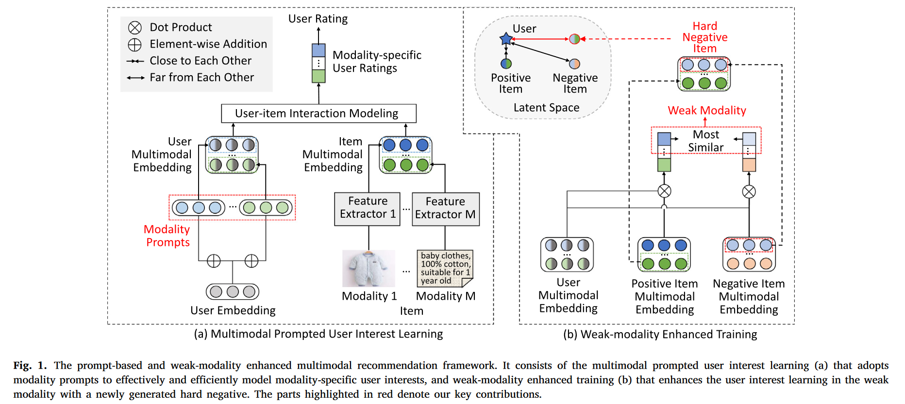
Problem Statement

Slide 4
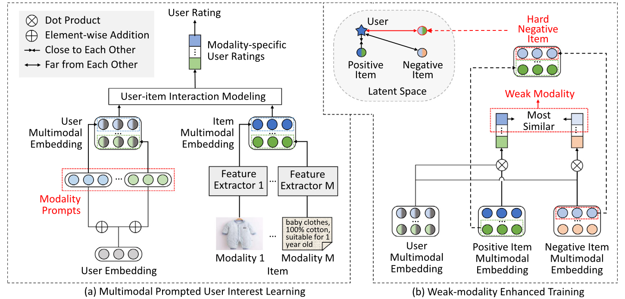
Method

Slide 5
Method

Slide 6
Experiments

Slide 7
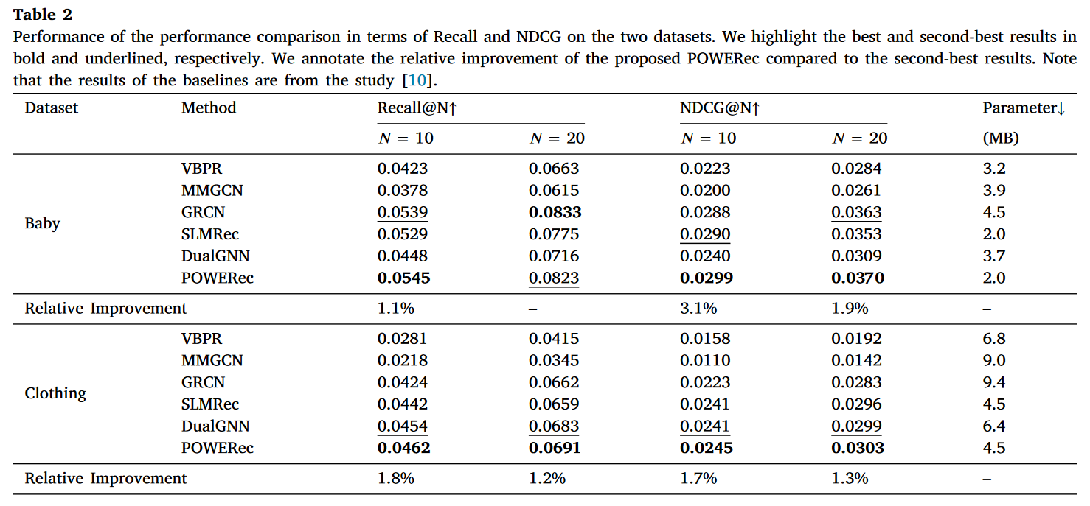
Experiments

Slide 8
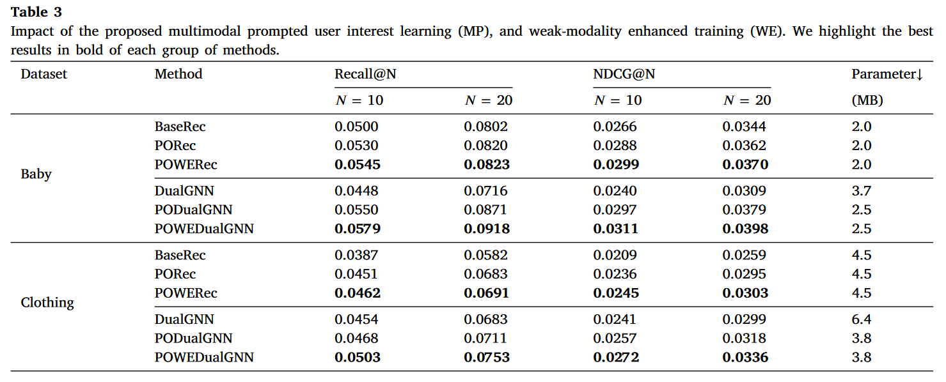
Experiments

Slide 9
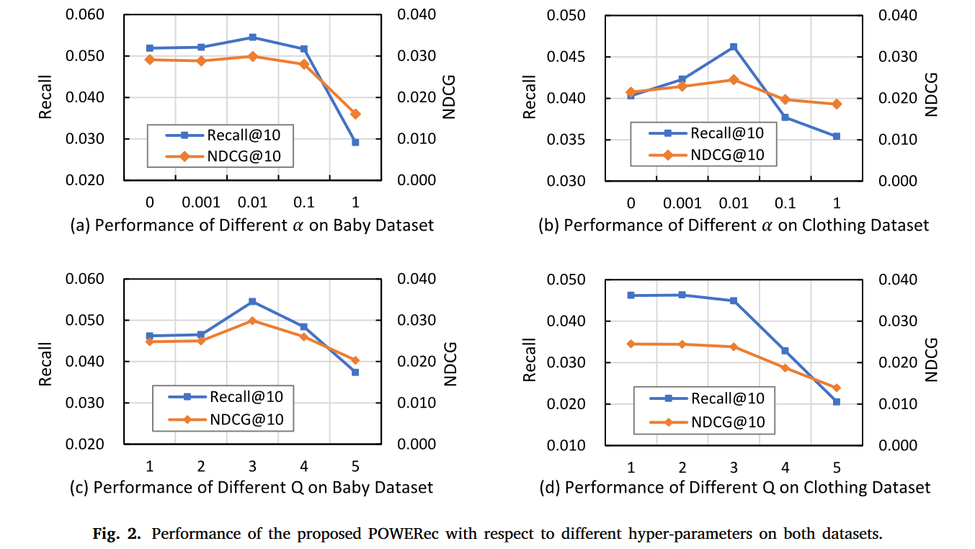
Experiments

Slide 10
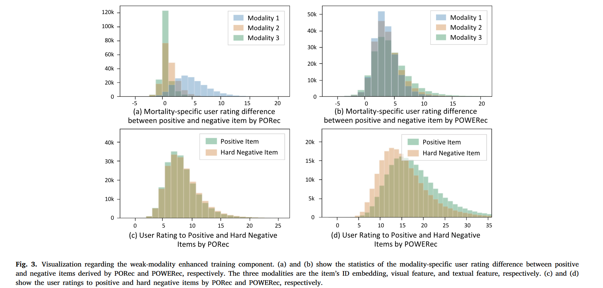
Experiments

Slide 11
Thanks

